Slide 1
Occupancy data set
Weather data set
Events data set
Data preparation
Random Forest Regression
R2 = .7133
MAE = 16.66
Staffing Recommendation

Slide 2
Data Collection and Exploration
Data Preparation
Quantitative: Secondary data Kaggle CSV and Met Èireann
Tools: Python, Pandas and Jupyter Notebook
Modelling and Evaluation
Tools: Scikit-learn, Random Forest and TimeSeriesSplit
Synthetic: AI generated events dataset
Methods: Feature Engineering, Lag features, Cyclical encoding, One-hot Encoding
Methods: Cross-validation, 80/20 split, R2 and MAE

Slide 3
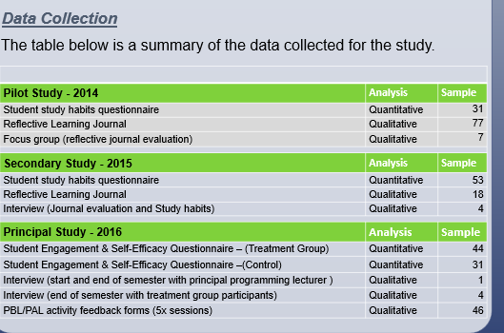

Slide 4
Occupancy Data set | Analysis | Sample
Arrivals, stay length, guests, ADR | Quantitative | 119,390
Non cancelled booking filtered | Quantitative | 46,228
Final daily occupancy rows | Quantitative | 793
Weather Data set | Analysis | Sample
Daily max temp, rainfall, weather quality | Quantitative | 1096
Events Data set | Analysis | Sample
Events and impact score | Quantitative | 1096

